Slide 1

Agentic FedGrid: Autonomous Privacy-Preserving Threat Detection
Department of Information Science Engineering
Final Year Project 2025-26
Progress & Results Review
By:
Mohith Kumar M-1JS23IS090
Anusha B-1JS23IS016
Lokesh Kumar Yadav-1JS22IS065
Rohan C Ravi-1JS24IS410

Slide 2
Overview
Introduction & Problem Statement
Objectives
Literature Survey
Project Scope & Key Deliverables
System Architecture & Tech Stack (As Built)
Evaluation Results
Live Deployment, Engineering Challenges & Limitations
Conclusion

Slide 3
Introduction
Traditional centralized intrusion detection compromises privacy and incurs high cloud costs. We built Agentic FedGrid, a decentralized framework of autonomous edge agents, and deployed it end-to-end: four EC2 edge nodes running a Tabular Transformer + LoRA classifier, a serverless AWS backend (API Gateway, Lambda, DynamoDB, S3) running real synchronous FedAvg rounds, and an explainable React dashboard — with only LoRA adapter weights ever crossing the wire, never raw traffic. Across four seeds, federated learning demonstrably recovers detection of a completely held-out attack class the global model was never trained on, without a single raw packet leaving the edge.

Slide 4
Project Overview
The Problem Statement (The Need)
  The Privacy Bottleneck: Organizations cannot legally or safely share sensitive network traffic logs to train centralized AI models.
  Failing Defenses: Traditional rule-based firewalls and static Intrusion Detection Systems (IDS) are ineffective against complex zero-day attacks and Advanced Persistent Threats (APTs).
  Cost & Latency: Uploading massive amounts of raw edge-device data to the cloud for security analysis is too slow and heavily inflates cloud computing costs.

Slide 5
Objective
Major Objective of the project
To engineer a decentralized, privacy-preserving Intrusion Detection System (IDS) that detects and neutralizes zero-day threats at the edge without ever exposing raw network logs to the cloud.
Important Goals
Autonomous Edge Defense: Deploy Agentic AI nodes capable of locally monitoring traffic and blocking malicious payloads in real-time without cloud authorization.
Privacy-Preserving Collaboration: Implement Federated Learning (FedAvg) so nodes share only mathematical intelligence, keeping all user data strictly on-device.
Zero-Cost Orchestration: Architect a highly scalable, serverless cloud backend to securely aggregate AI weights at zero compute cost.
Advanced Pattern Recognition: Utilize Tabular Transformers to detect the hidden, sequential patterns of complex attacks like Advanced Persistent Threats (APTs).
Status: all four objectives implemented, deployed, and measured against held-out data — see Evaluation Results and Live Deployment ahead.

Slide 6
Literature Survey
Authors/Year | Primary Focus | Proposed Architecture | Keyfindings | Drawbacks
Muthuswamy et al. (2026) | Federated IoT Intrusion Detection | Hybrid Transformer + XGBoost + Fusion Head | Utilized LoRA adapters to reduce FL communication overhead by ~89.5% while managing severe class imbalance. | Challenged by complex, low-frequency web and injection attacks (like SQLi and XSS) because their payloads closely resemble legitimate traffic.
Devi et al. (2025) | Vision Transformers for Cybersecurity | FAT-ViT (Federated Adaptive Training + ViT-Lite) | Converted network traffic to 2D visuals to capture spatial relations ; used Contrastive Adversarial Training to improve robustness against evasion. | The process of converting network traffic logs into two-dimensional visual representations introduces mandatory preprocessing overhead before the AI can analyze the data.

Slide 7
Literature Survey
Authors/Year | Paper | Proposed Architecture | Key findings | Drawbacks
Vijetha (2026) | Self-Adaptive Threat Detection | AISAF (CNN-LSTM-Transformer + Meta-Optimization) | Autonomously detects concept drift without explicitdensity estimation and selectively retrains submodules, achieving rapid recovery. | Currently relies on fixed window segmentation, which may underperform in ultra-low-latency streams where drift occurs at sub-millisecond timescales. Explainability remains feature-centric and lacks causal reasoning.
Panwar & Abdelrahman (2025) | Agentic AI Review | N/A (Literature & Framework Review) | Outlined the shift to autonomous Agentic AI, highlighting the need for self-learning security models and human-AI collaboration. | Highlights inherent risks in autonomous systems, including AI bias from training data, susceptibility to adversarial manipulation, and the dangers of completely removing human oversight.

Slide 8
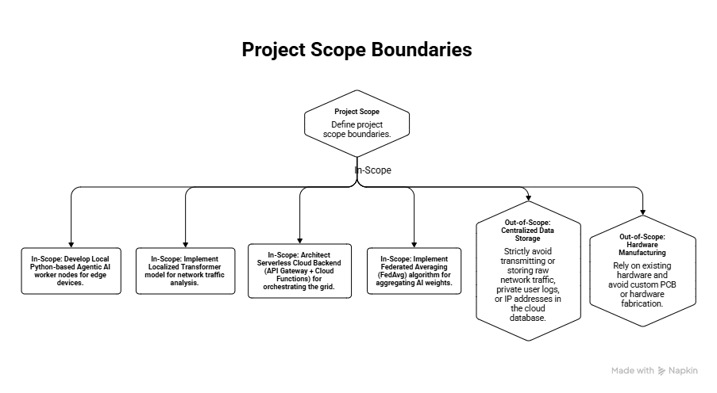

Slide 9
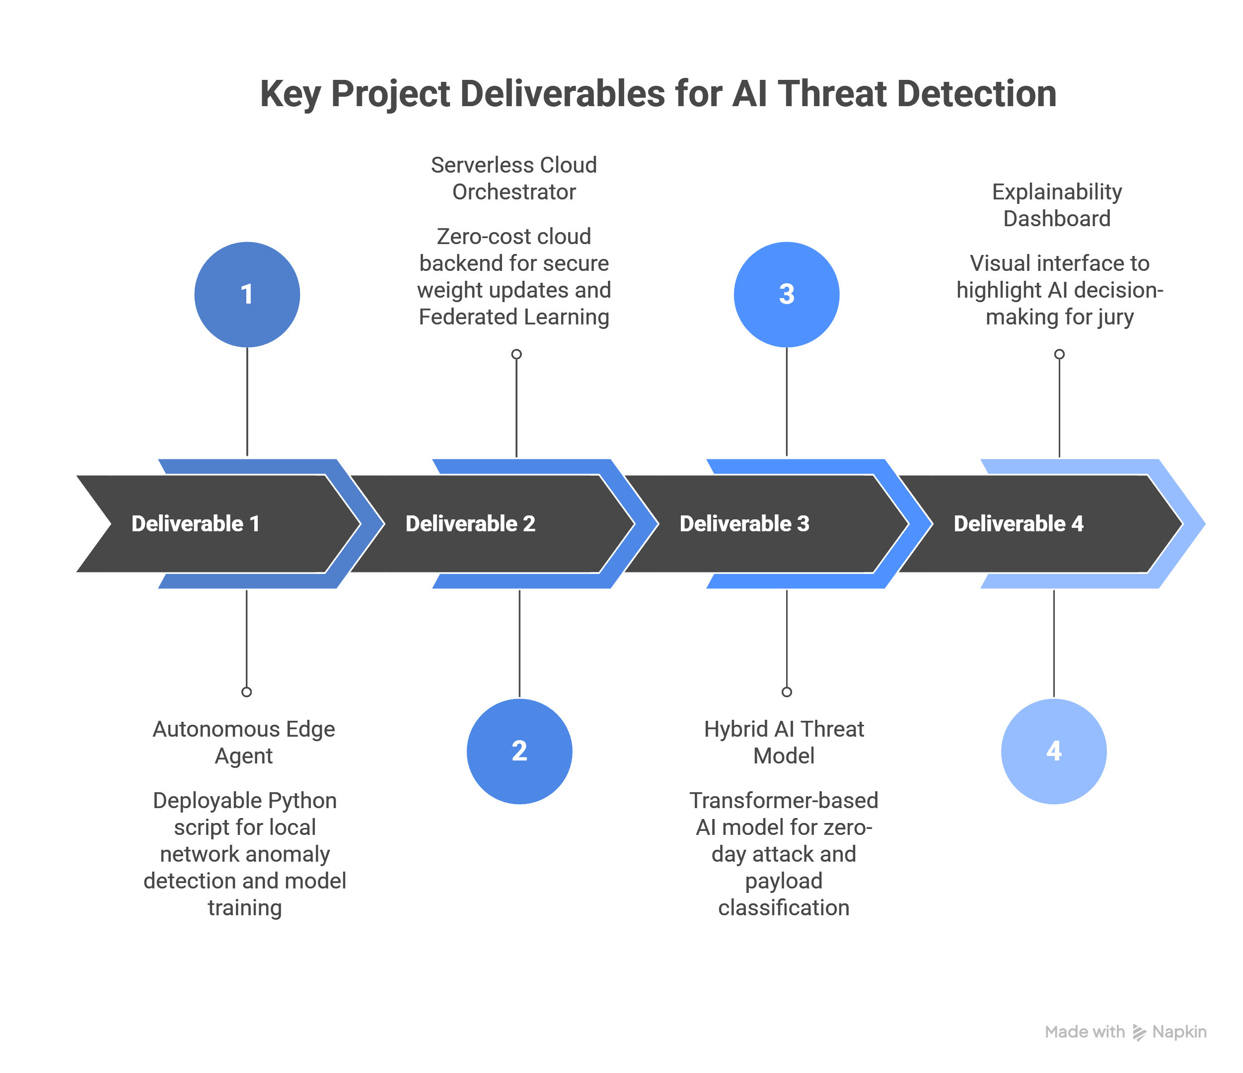

Slide 10
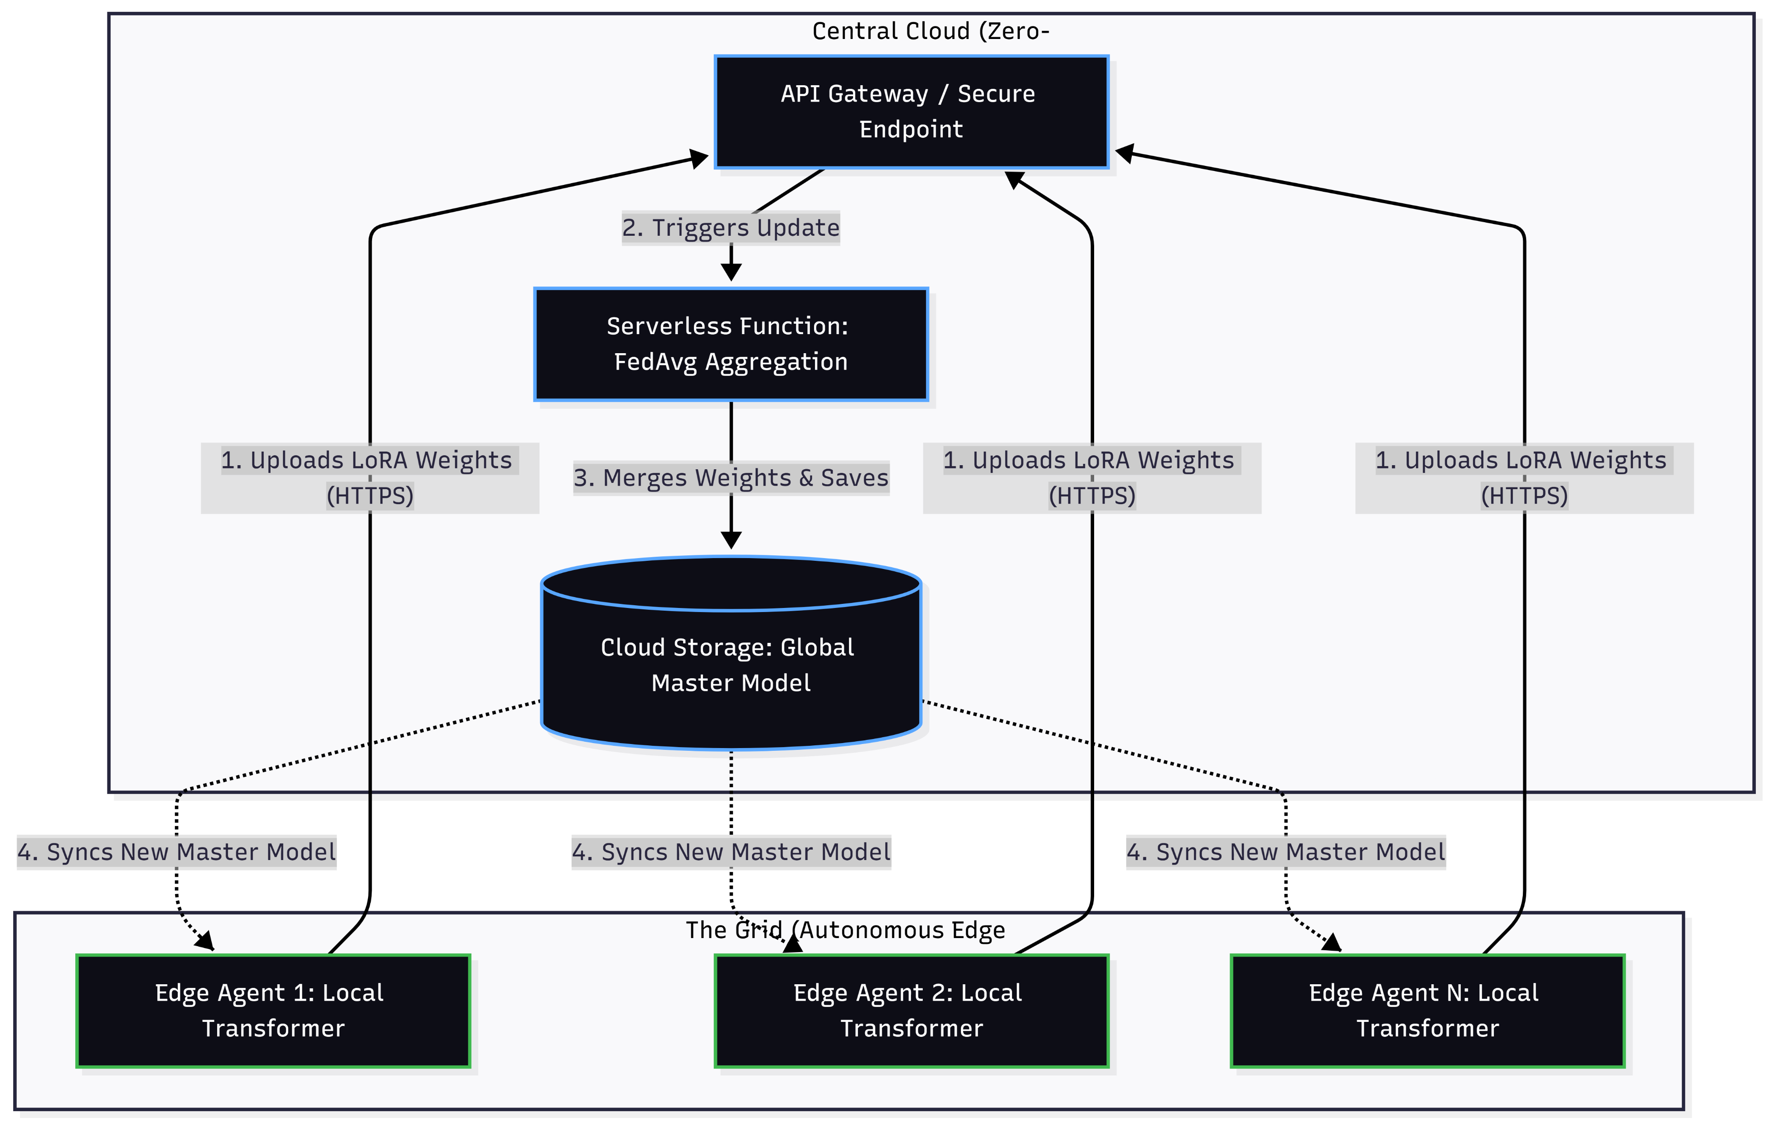
System Architecture — As Built

Slide 11
Technology Stack — As Built
Techniques, Tools & Technologies
Edge Compute (Worker Nodes): Python, PyTorch, Tabular Transformer (d_model=32, 4 heads, 2 layers) + HuggingFace peft (LoRA r=4, α=8) — runs as a systemd service on each edge node.
Cloud Orchestration (The Brain): AWS SAM — API Gateway, 6 Lambda functions (ingest / model / incident / rounds / incidents-read / straggler-aggregate), DynamoDB (round + incident state), S3 (adapter + global model storage), EventBridge (straggler timeout).
Access, Data & Explainability: SSM Session Manager only, no SSH — UNSW-NB15 + ToN_IoT (Dirichlet non-IID split, 4 devices), attention-rollout explainability, React + Recharts dashboard.

Slide 12
Evaluation Results — Detection Performance
Metric | UNSW-NB15 (82,332 rows) | ToN_IoT (31,656 rows)
Accuracy | 87.19% | 98.84%
Macro F1 | 0.8706 | 0.9840
False Positive Rate | 14.31% | 1.93%
Fuzzers Recall (official test, 6,062 rows) | 41.06% | —
Inference Latency (median / p95) | 2.88 ms / 6.65 ms | same model
Adapter Payload Size (per round) | 14.56 KB | same model

Slide 13
Evaluation Results — Federated Zero-Day Recovery
Round | Cumulative Fuzzers Exposure | Official-Test Recall | Replay-Set Accuracy | General Accuracy (FPR)
0 (before) | 0% | 41.06% | 28.14% | 87.19% (14.31%)
4 (after, mean ± std, 4 seeds) | 100% | 49.13% ± 2.49pt | 36.97% ± 3.07pt | 86.55% ± 0.12pt (17.71% ± 0.71pt)
Net change | — | +8.07pt ± 2.49pt | +8.83pt ± 3.07pt | −1.3pt acc / +3.4pt FPR

Slide 14
Live Deployment & Demo
A real, deployed system — not a simulation
Cloud stack: AWS SAM stack “fedgrid” (ap-south-1) — API Gateway, 6 Lambda functions, DynamoDB (round + incident state), S3 (adapter + global model), EventBridge straggler timeout.
Edge nodes: 4 EC2 instances, SSM Session Manager only (no SSH, no inbound rules) — each runs the agent as a systemd service against the live API.
Dashboard: React + Recharts, polls /rounds and /incidents — round-by-round federated validation accuracy, live incident feed (BLOCK / ALERT / RETRAIN / MISS), attention-rollout explainability per detection.
Demo script: replay a held-out attack class the global model has never trained on → logged as MISS → the one device holding that class locally retrains → FedAvg round completes → new global adapter redistributed → the same replay is now BLOCKed on devices that never saw the raw attack traffic.

Slide 15
Engineering Challenges & Fixes
Real bugs, found and fixed — disclosed, not hidden
LoRA base weights never trained: found via direct inspection (requires_grad=False from construction) — the "adapter" was correcting a permanently-random matrix since day one. Fixed by training the FFN base jointly, then merging LoRA into it before freezing; backbone retrained, every number re-measured.
Local-retraining dilution & catastrophic forgetting: a first fix over-corrected — general false-positive rate exploded 12%→65% chasing the headline recall number. Caught by deliberately checking general performance, not assumed safe; fixed with bounded hard-example-weighted sampling.
Demo-day incident (Sept 21): all 4 EC2 nodes were silently terminated by the deploy identity — re-provisioned. CORS was misconfigured (a first fix missed the browser’s real preflight OPTIONS request). A DynamoDB scan-before-sort bug was serving week-old stale incidents.
Straggler quorum lowered 2→1: discovered devices 2–4 have no organic reason to ever retrain — their own-buffer accuracy (96–99%) sits far above any reasonable self-eval trigger, so requiring 2 participants meant a round could never complete.

Slide 16
Limitations & Future Work
  Single shared adapter, heterogeneous devices: one device retraining on UNSW-flavored data degrades ToN_IoT calibration disproportionately (FPR moved ~9x on ToN_IoT vs ~2x on UNSW in one measured run) — future work: per-source-domain adapter conditioning.
  peft migration halved the zero-day recovery gain: +8.07pt vs +20.05pt (official-test recall) after switching hand-rolled LoRA → HuggingFace peft; most likely cause is train_backbone.py never seeding torch itself — needs a controlled re-run to confirm.
  Inference latency grew ~4x post-migration: 2.88ms median vs 0.72ms (still comfortably under the 50ms target) — a real library-overhead cost of peft’s wrapper indirection, disclosed rather than hidden.
  Incident store is a stopgap: DynamoDB Scan-then-sort with a 100,000-item runaway-growth cap — a real deployment needs a GSI on timestamp instead of scanning the whole table.
  Scope narrowed from the original synopsis: mitmproxy and the CICIDS17/18, BoT-IoT, CICIoT2023 datasets were dropped in favor of UNSW-NB15 + ToN_IoT only — noted here rather than left as a silent mismatch.

Slide 17
Conclusion
Agentic FedGrid is built and deployed end-to-end on real infrastructure — four autonomous EC2 edge agents, a serverless AWS backend running genuine synchronous FedAvg rounds, and an explainable React dashboard — not a simulation. Across four seeds, federated learning recovers zero-day detection ability for a completely held-out attack class without a single raw packet ever leaving the edge, and every number in this deck, including the regressions and open limitations, was measured against genuinely held-out data, not asserted. What remains before final submission is scoped explicitly in Future Work, not hidden.

Slide 18


